Slide 1
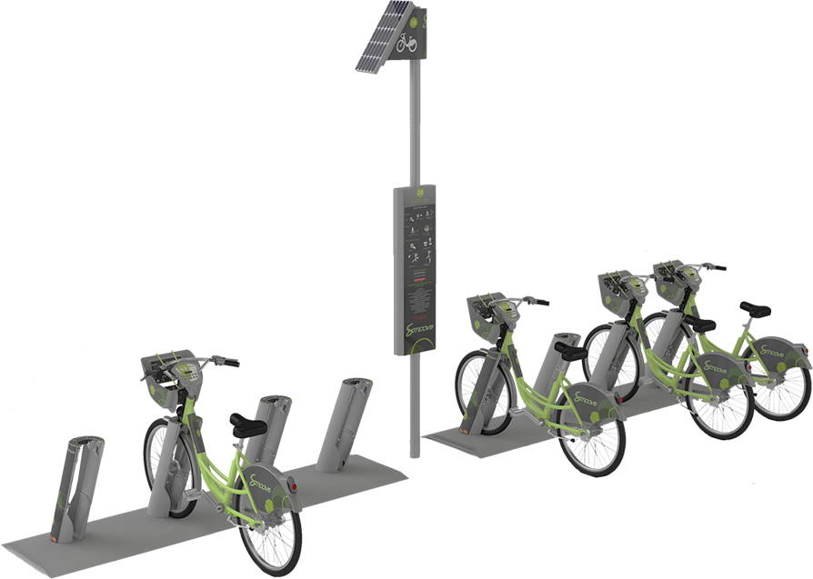
Bike Rental Prediction
April 5th, 2023
Mohammad Ahmadi
Zach Huntley
Anurag Singh

Slide 2
Background
Seoul’s Bike Sharing System
Established in 2015 with 150 stations and 1500 bikes.
As of July 2016, they have expanded to 300 stations and 3000 bikes.
Users rent bikes for temporary use ( usually less than half an hour)
Users rent bicycle from stations.
Allows users to leave the rented bikes any place they wish .
Company is responsible for collecting the bikes and redistributing them across the stations

Slide 3

Problem Statement
Cost
Purchasing new bikes
Maintenance
Fluctuating Demand
Decrease customer satisfaction

Slide 4
Solution
Prediction of the number of bicycles needed on an hourly basis each day help:
Efficient use of the current bikes (reduce purchase cost)
Collecting undemand bikes across the city ( reduce maintenance cost)
Satisfying the demand efficiently
Predictors
Weather conditions
Holidays
Seasons
Hour of the day

Slide 5
Target
Predicting the number of bikes rented each hour of the day in Seoul Bike Sharing System based on different weather conditions and holidays

Slide 6
Dataset
Date : DD/MM/YYY
Rented Bike Count
Hour
Temperature(°C)
Humidity(%)
Wind_speed(m/s)
Visibility_(10m)
Dewpoint_temperature(°C)
Solar_Radiation_(MJ/m2)
Rainfall(mm)
Snowfall(cm)
Seasons
Holiday
Functioning_Day
From 1/12/2017 to 30/11/2018
https://archive-beta.ics.uci.edu/

Slide 7
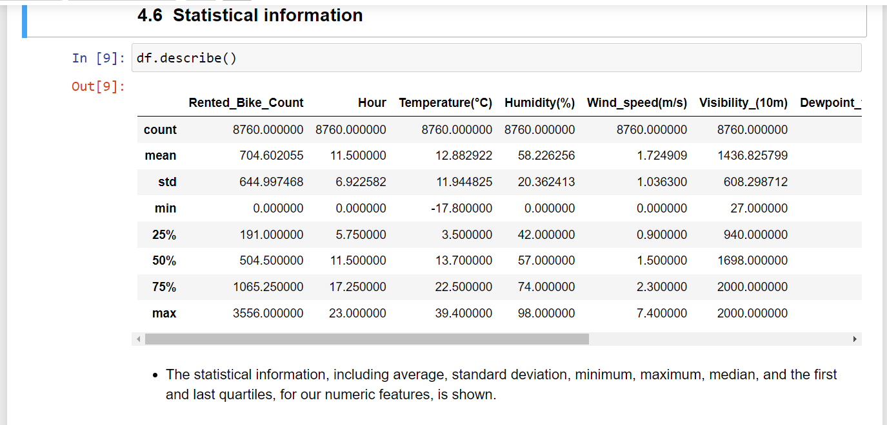
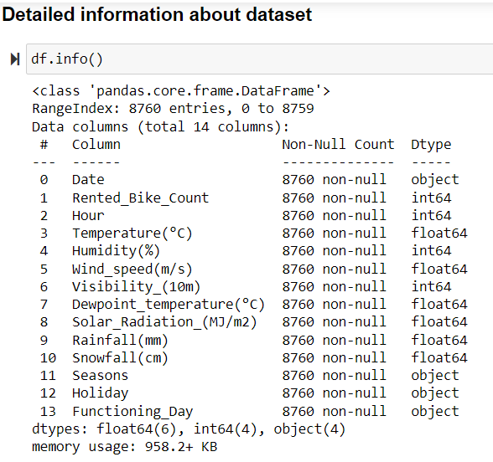
Exploratory Data Analysis
Includes:
Checking the shape of the dataset
Datatypes of each variable
Number of unique values for each column.
Checking statistical information

Slide 8
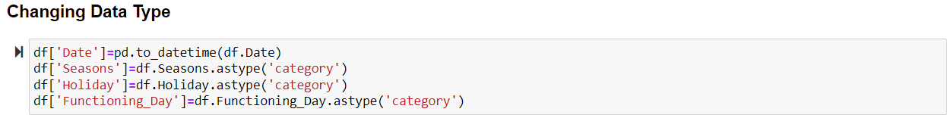
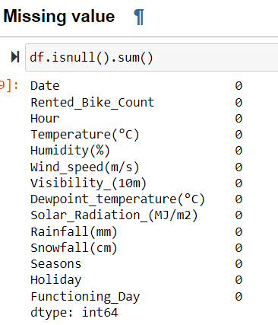
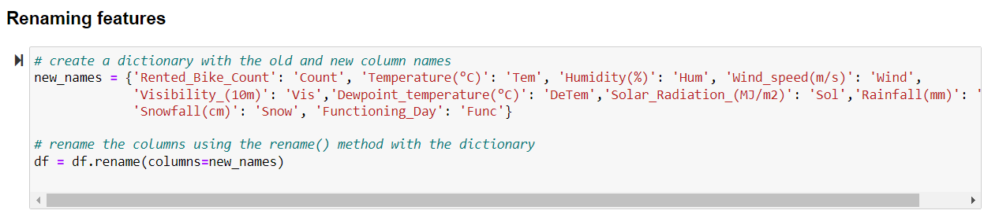
Data Preparation
Steps included:
Changing data types
Renaming the features
Checking for missing values

Slide 9
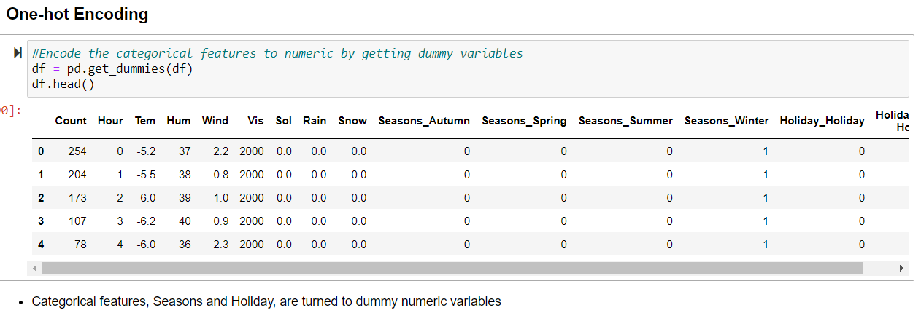
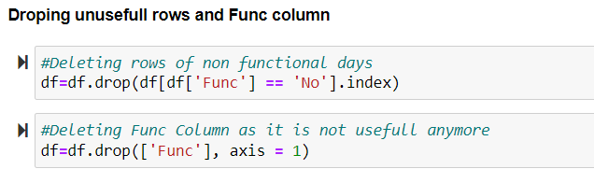
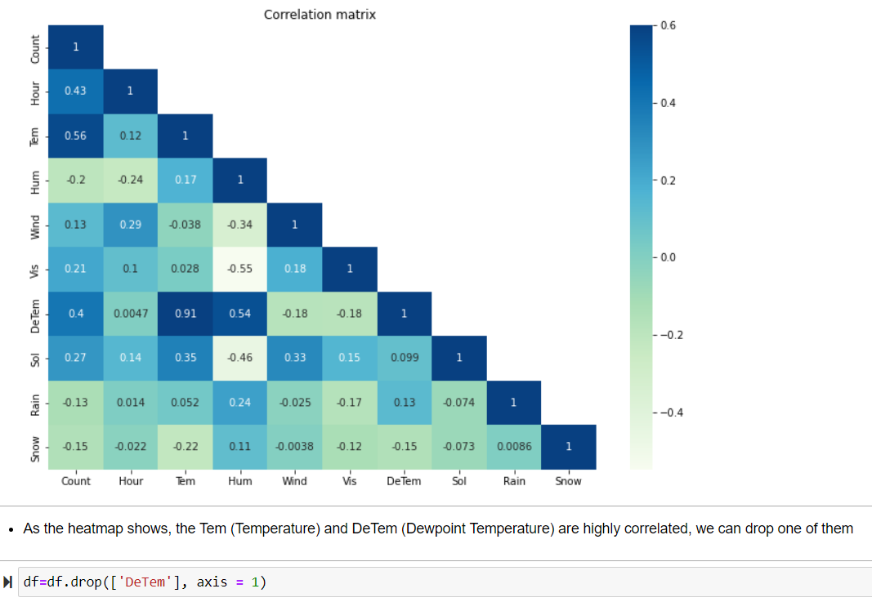
Feature Engineering
Steps included:
Dropping unnecessary columns (Date, Func, DeTem).
Checking for outliers.
Using One-hot Encoder to change categorical features to numeric by getting dummy variables.

Slide 10
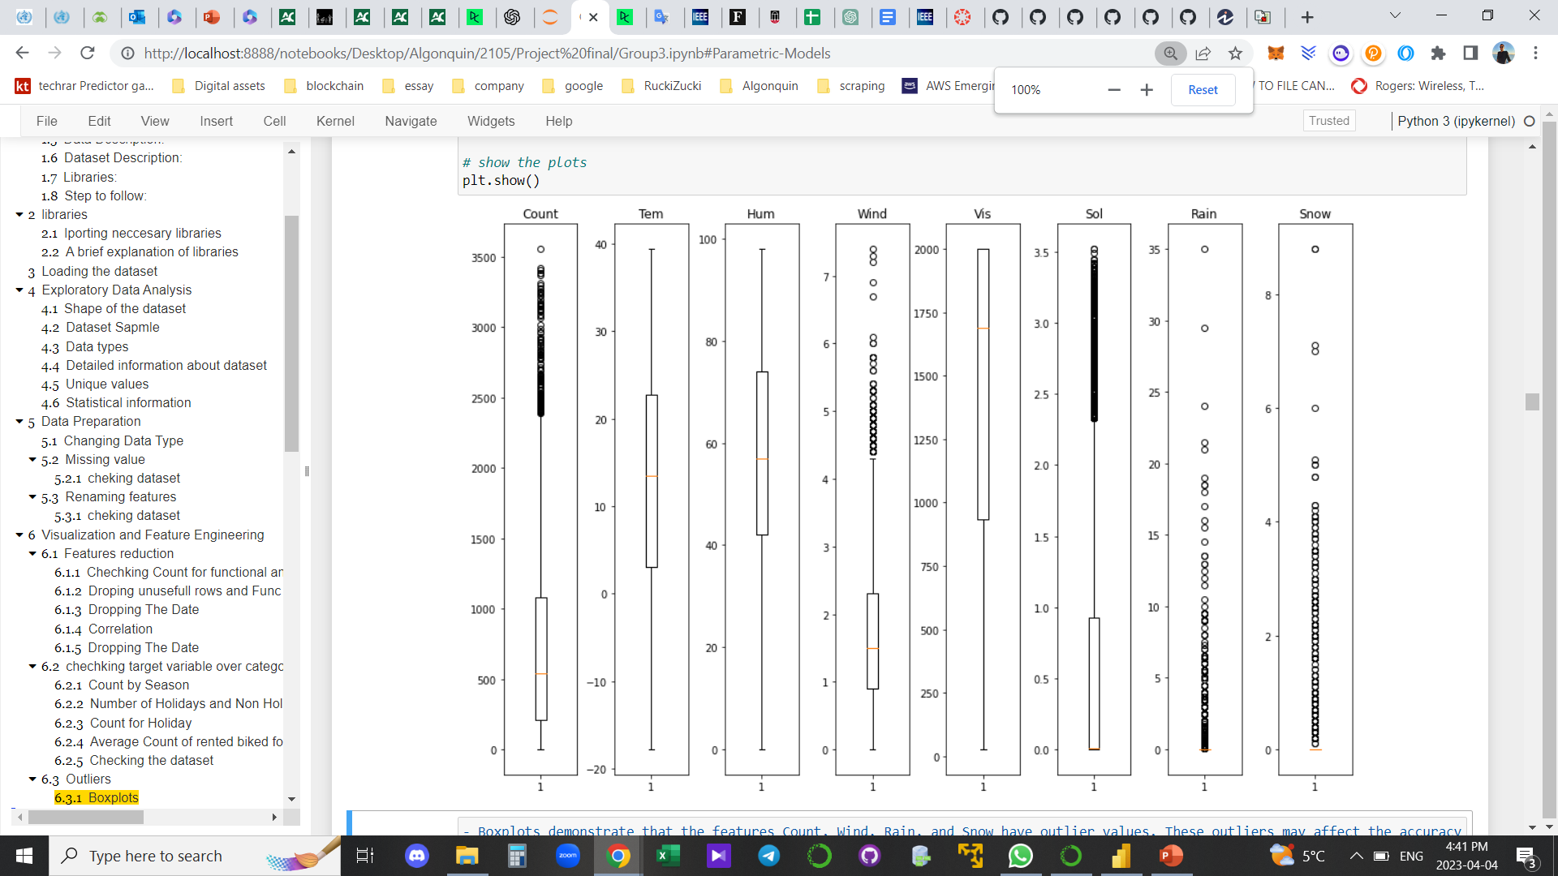
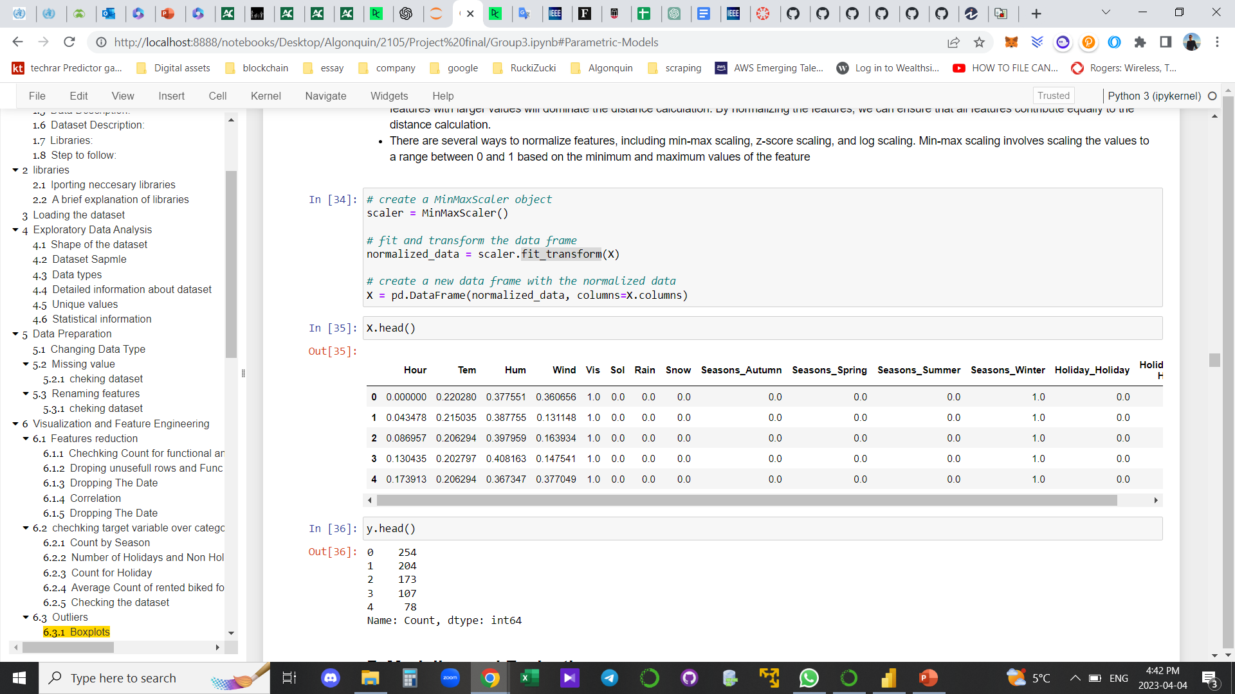
Feature Engineering
Outliers
Normalization

Slide 11
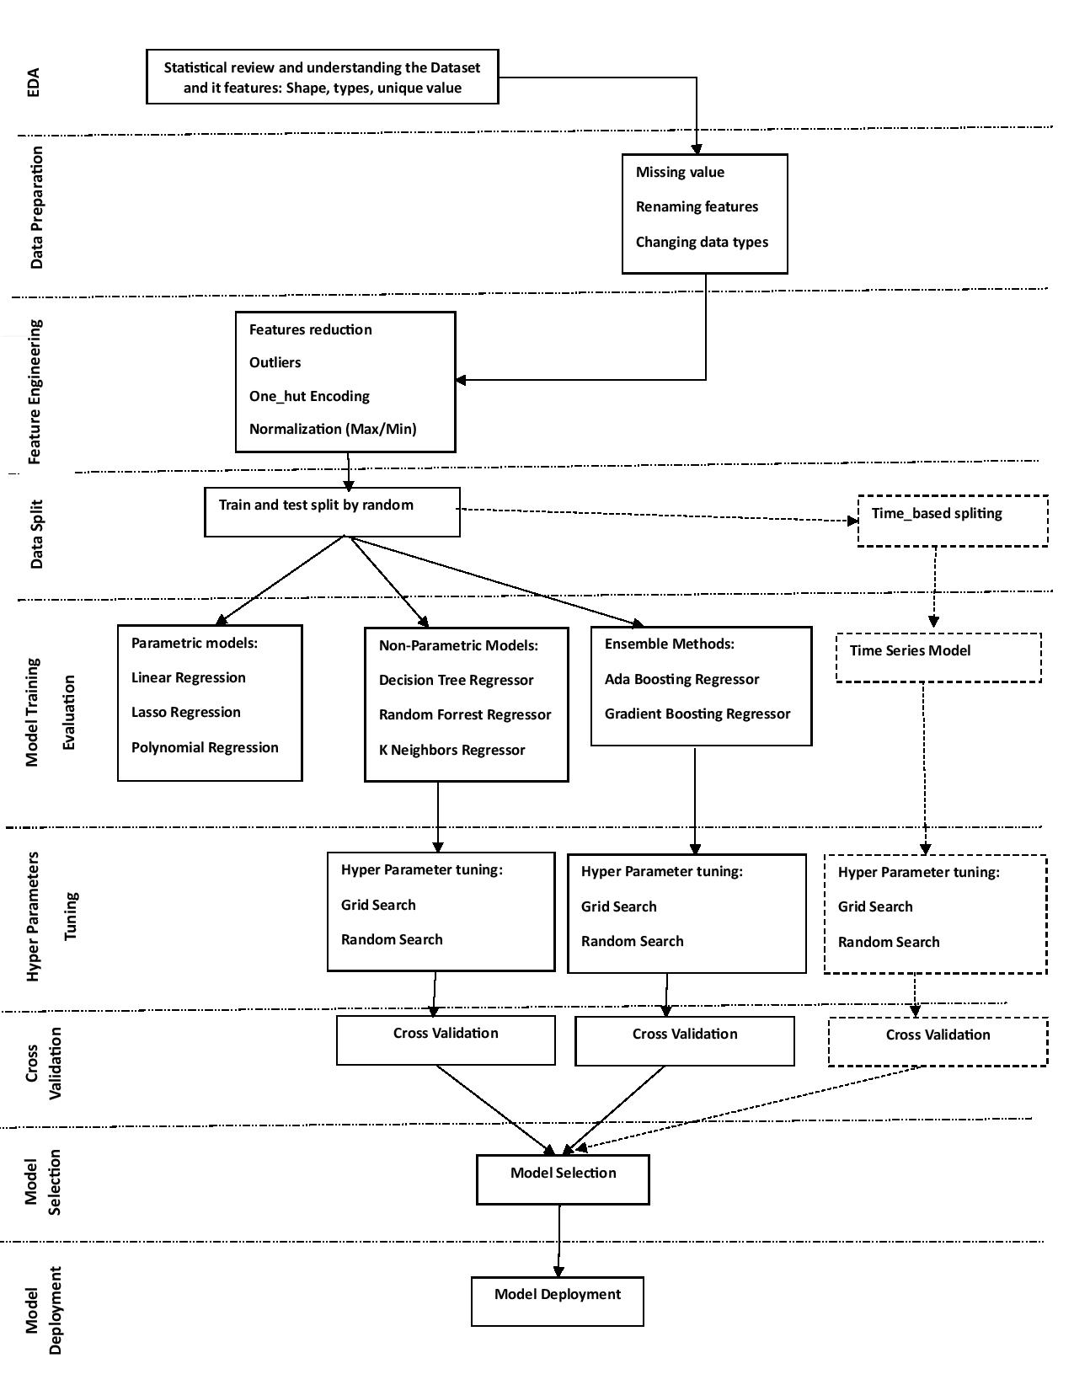
Modelling Pipelines Diagram
Notes:
•So before we get in to our 3 main pipelines, the steps involved beforehand were: Exploratory Data Analysis, Feature Engineering and Data Splitting.
•This is our first pipeline where we used simple regression models like Linear, Lasso, and Polynomial regression.
•For our second pipeline we used more complex models like Decision Tree, Random Forest and Kneighbours Regressor.
•And for our third pipeline we used ensemble methods like ADA boosting regressor and gradient boosting regressor.

Slide 12
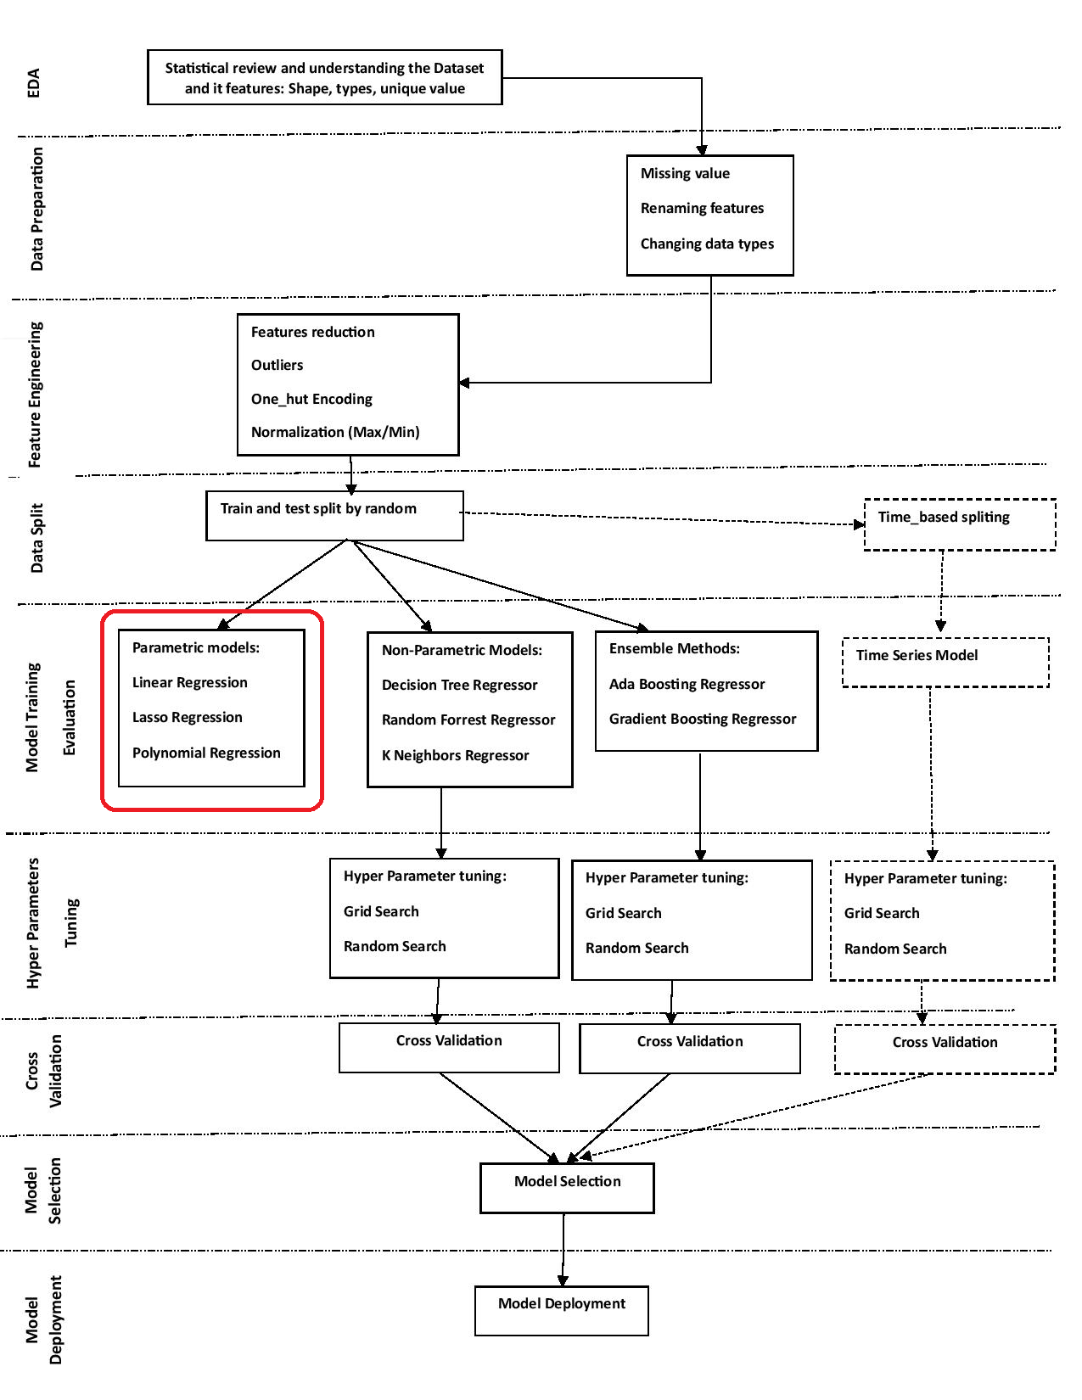
First Pipeline
Parametric Models
Notes:
For our first pipeline we evaluated our data with parametric models like Linear, Lasso and Polynomial Regression models.
We started with these models to see if they were able to predict our data.

Slide 13
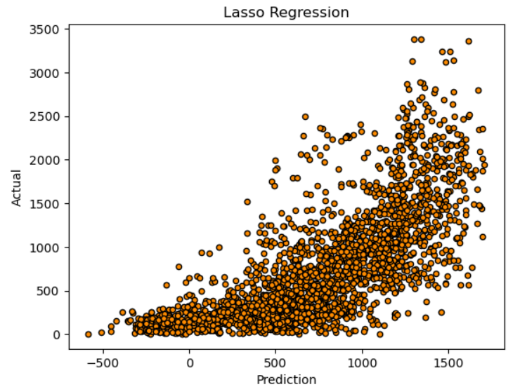
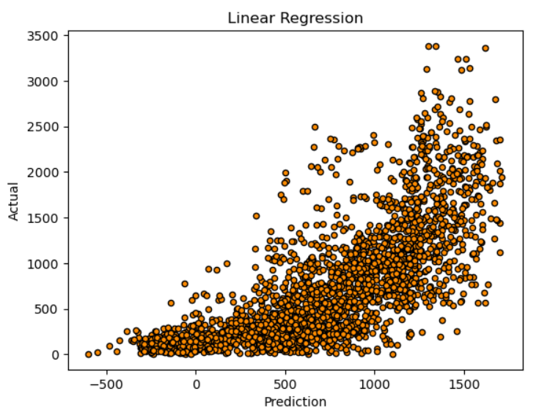
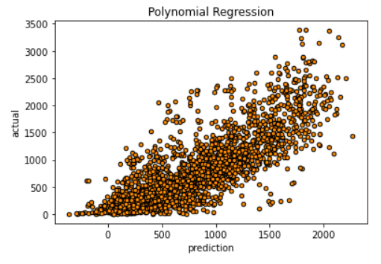
Parametric Models
Models used include:
Linear Regression
Lasso Regression
Polynomial Regression
Notes:
Here are some visuals of the models.
On these charts we have the actual value on the y axis, and the predicted value on the x axis.
If the models were accurate, all the data points would be closer to the center of the chart.
Judging by these charts you can see that these models are underfitting the data.

Slide 14
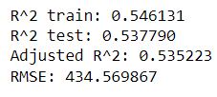
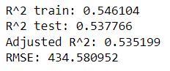
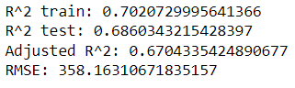




Models Evaluation
Evaluation Metrics include:
R-squared (R²)
Adjusted R-squared (adjusted R²)
Root mean squared error (RMSE)
Adjusted R-squared is a modified version of R-squared that adjusts for the number of variables in the model. It is used to get a more accurate metric for the model and is always lower then R2
Results:
Linear Regression
Lasso Regression
Polynomial Regression
Notes:
For evaluation metrics we used R squared, Adjusted R squared and Root Mean Square Error.
R squared is a statistical measure used to evaluate how closely the regression line fits to the actual data point.
Adjusted R squared is a modified R squared that adjusts for the number of variables in the model. It is used to get a more accurate metric for the model and is always lower then the normal R squared.
And RMSE measures the difference between the predicted value and the actual value. So a lower RMSE, the better the fit.
As you can see the Linear Regression model has an R squared value of 0.54 in the training data, which means that it is 54% accurate when predicting the target variable.
This indicates that are model is underfit and inaccurate.
We then tried to use other models like Lasso and Polynomial regression to see if we could get better results but they were also underfitting our data.
Polynomial regression had the best result with an R squared of 0.7 but it still wasn’t the result we were looking for, so we moved on to other models.

Slide 15
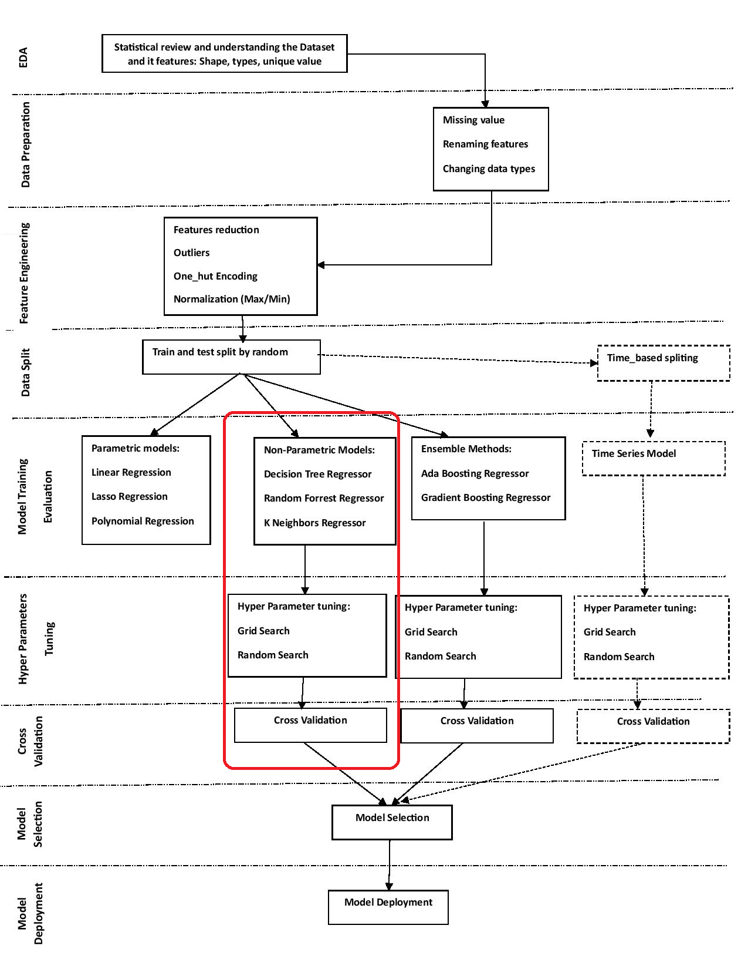
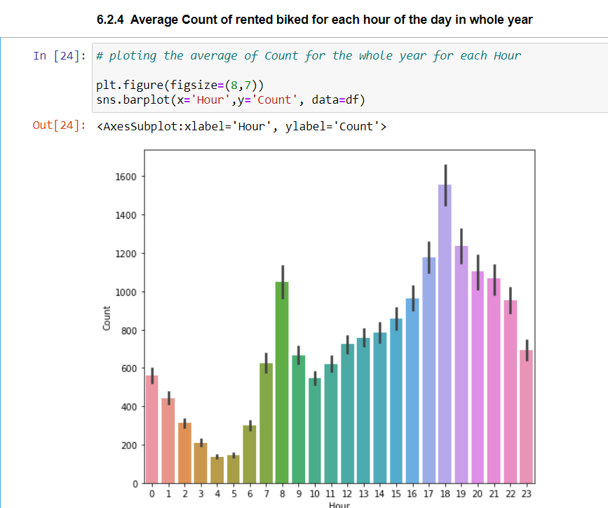
Second Pipeline
Notes:
For our second pipeline we changed to more complex models like decision tree, random forest and KNeighbour Regressors.
Are rational for choosing these models was when you looked at the distribution of our target value compared to variables like time of a day, you can see a pattern in certain hours of the day.
For example – 3-4am have lower bikes rented compared to 6-7pm.
Based off this information we made the assumption that decision tree based models would be a better fit for our data compared to simple regression models.
So after underfitting our data on the parametric models we decided to go with non parametric models instead

Slide 16
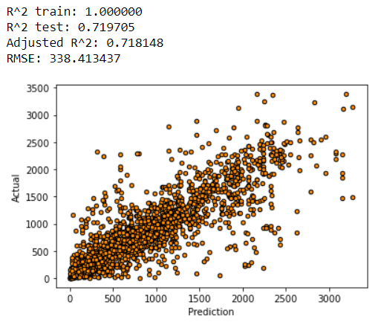
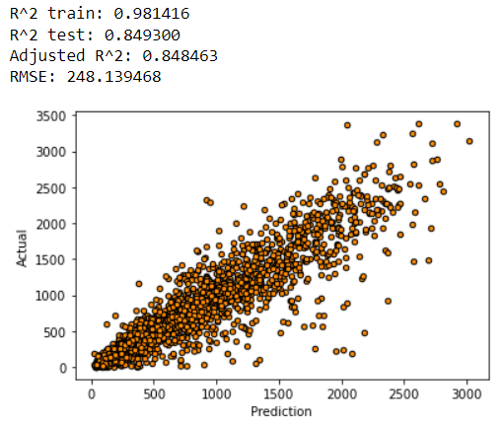
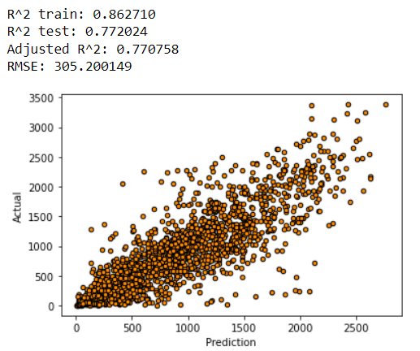



Non- Parametric Models
Models included:
Decision Tree Regressor
Random Forest Regressor
K-neighbors Regressor
Results:
Decision Tree Regressor
Random Forest Regressor
K-neighbors Regressor
Notes:
Here are the results for our non parametric models with the same evaluation metrics as the other models
As you can see they performed better than the parametric models but they are now overfitting the data.
R squared in the train data set isnt close to the R squared in the test set, so we will use hyper parameter tuning to see if we can fix the overfitting issue.

Slide 17
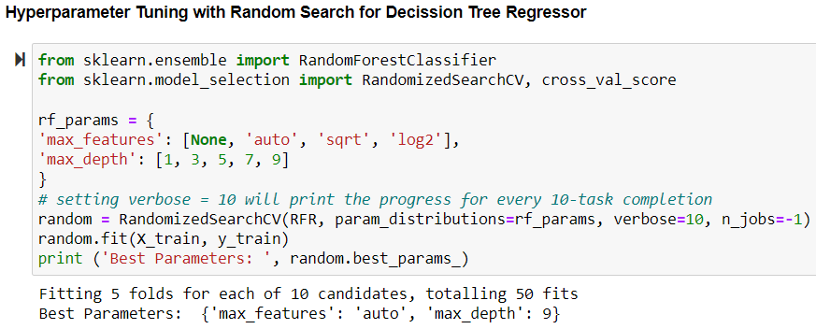
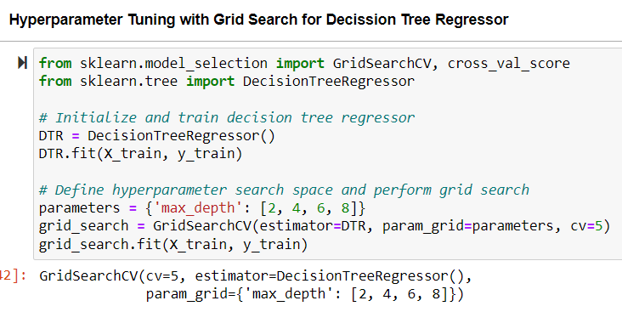
Hyper Parameter Tuning
The process of finding the best set of hyperparameters for a machine learning model to achieve optimal performance.
Methods used:
Grid Search
Random Search
Notes:
For Hyper Parameter Tuning we used two methods:
Grid Search
And Random Search

Slide 18
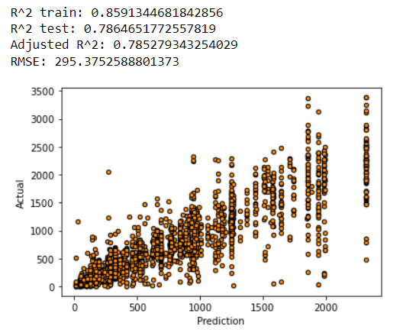
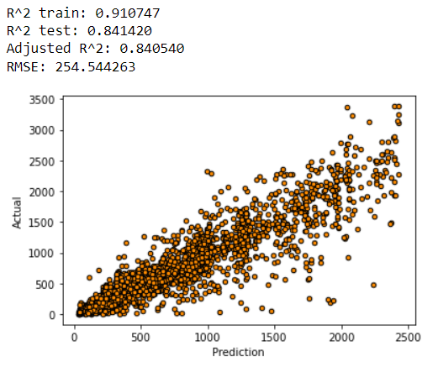
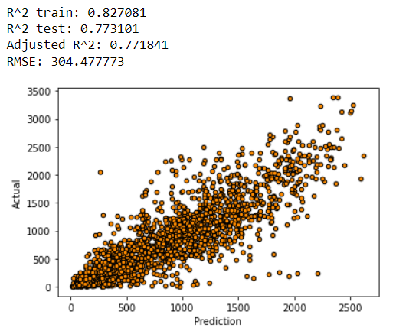



Hyper Parameter Tuning
The process of finding the best set of hyperparameters for a machine learning model to achieve optimal performance.
Results:
Decision Tree Regressor
Random Forest Regressor
K-neighbors Regressor
Notes:
Here are the results after using hyper parameter tuning.
As you can see, we got much better results with the new parameters.
RMSE has performed better on these models and have dropped under 300 for all models
The gap between our Train set and test set is much smaller but is still overfitting the data
We will compare these models later in the model selection part, now we will go into a third pipeline to see if we can get better results.

Slide 19
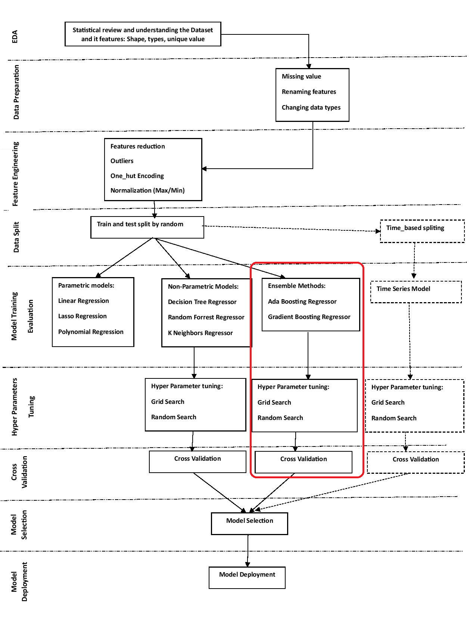
Third Pipeline
Notes:
First a summary from the beginning
Then go to third pipeline

Slide 20
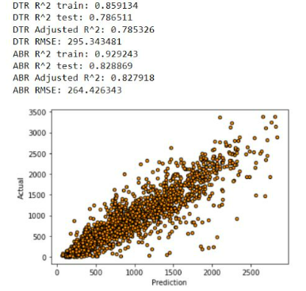
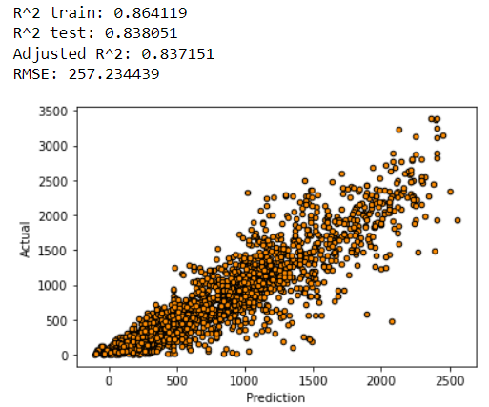
Ensemble Methods
Methods Used:
ADA Boosting Regressor
Gradient Boosting Regressor
Results:
ADA Boosting Regressor
Gradient Boosting Regressor
Notes:
We had the same rational in the second pipeline here to choose this two ensemble methods. Decision tree is the underlying mechanism for both of them.
boosting algorithms convert the weak learners into strong learners.
But they have two different approaches, while Ada use increasing class weights in each iteration to pay more attention to the loss and make them predicted, Gradient , as its name suggests, use minimizing the residuals of each iteration by training a model on them.
Comparing the results.
Note that we still have some overfitting problem which lead us to the next step

Slide 21
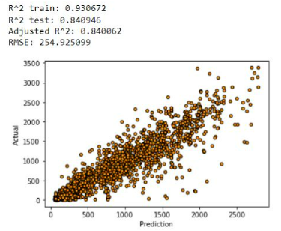
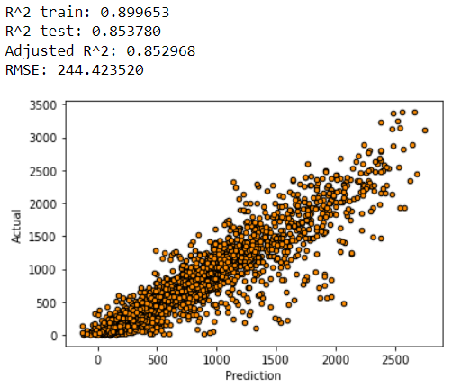
Hyper Parameter Tuning for Ensemble Methods
Results:
ADA Boosting Regressor
Gradient Boosting Regressor
Notes:
We just went further a little bit and tuned or hyper parameter here.
Although we could enhance the models performance by almost 2 percent, but it did not worth it as you it is really computationally expensive .
It got more than half an hour to run

Slide 22
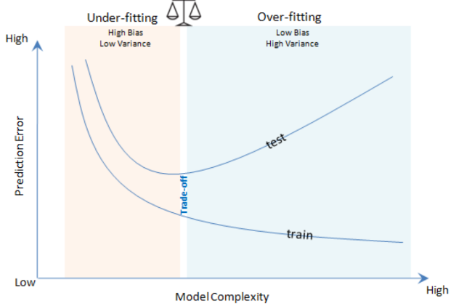
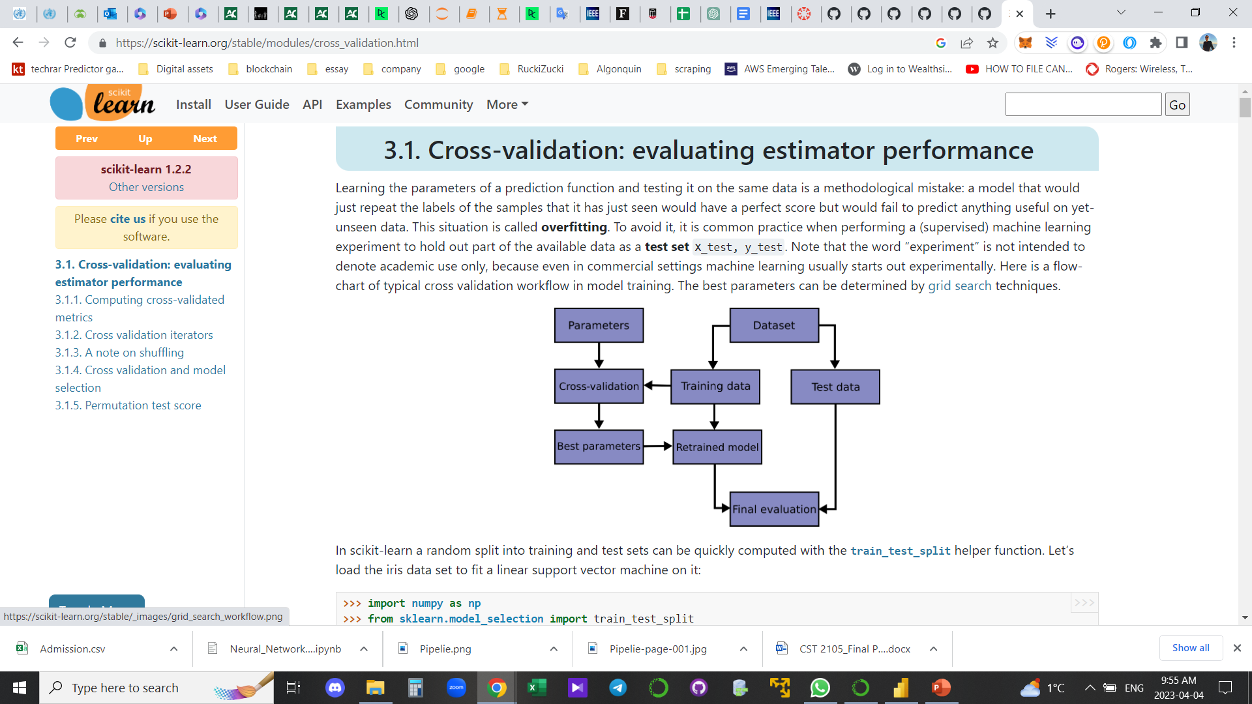
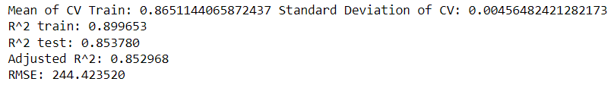



Cross Validation
Results for Cross Validation for Gradient Boosting Regressor:
Notes:
A big challenges in supervised learning is the bias-variance tradeoff.
As you saw, even after hyper parameters tuning we still had some overfitting issue in some models.
But cross validation helps us to get a more accurate estimate of the generalization error of our model, and to identify whether our model is overfitting or underfitting the data.
Furthermore, two compare different models we had ,we need to be sure about the best accuracy of each model. So we decided to do cross validation for all model before going to the model selection section

Slide 23
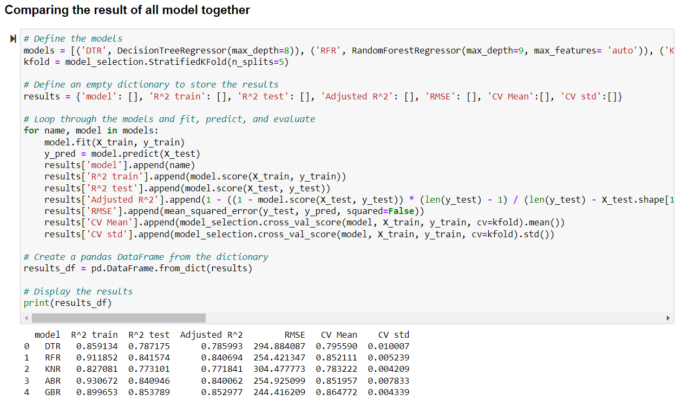
Model Selection

Slide 24
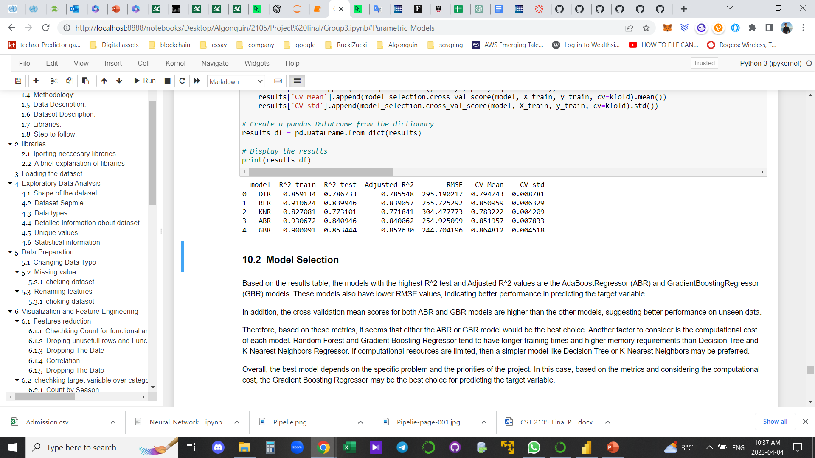




Model Selection
Models with the highest R2 and Adjusted R2 values are ADA and Gradient Boost Regressor.
Cross validation mean score for both ABR and GBR are also higher than the other models.
Best Performance: Gradient Boosting Regressor
Notes:
After cross validation we almost the overfitting issue for almost all of the models
GBR is the best model as has lowest RMSE and highest CV R2

Slide 25
Conclusion
Gradient Boosting Regressor had the lowest RMSE and the highest R2 score, making it the best model for this project.
The selected model had a high level of accuracy in predicting the number of bicycles needed on an hourly basis, which can help Seoul's bike sharing system efficiently manage its resources, leading to cost reduction and better service for customers.
The project successfully achieved its objective:
demonstrated the potential of machine learning models to accurately predict the demand for bike sharing systems based on weather conditions
Notes:
So after running different stages, and based on the evaluation metrics we used we could have reasonable prediction

Slide 26
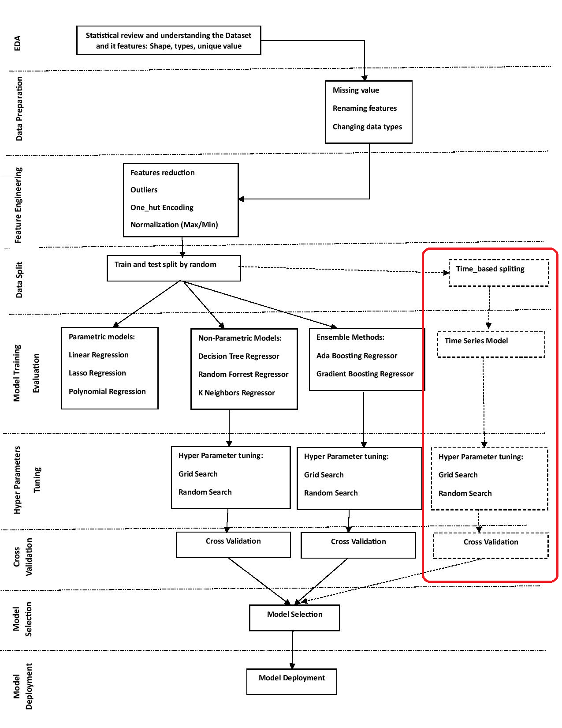
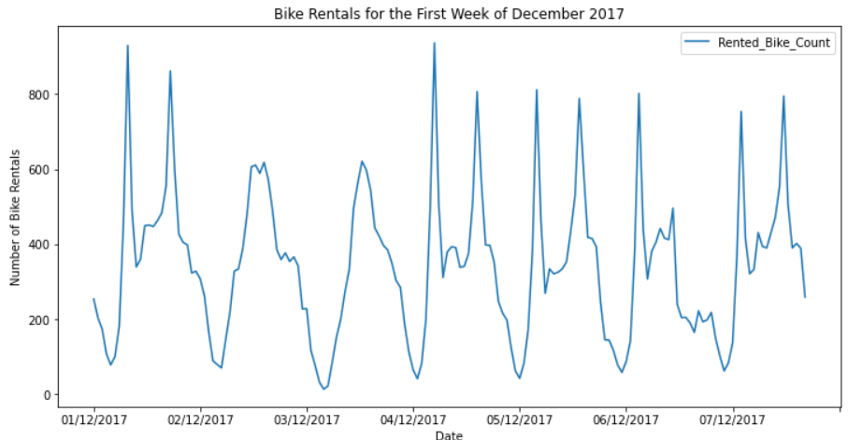
Recommendation:
Time series analysis is a powerful method that can be highly effective in machine learning projects where the data is time-dependent and shows some patterns over time.

Slide 27
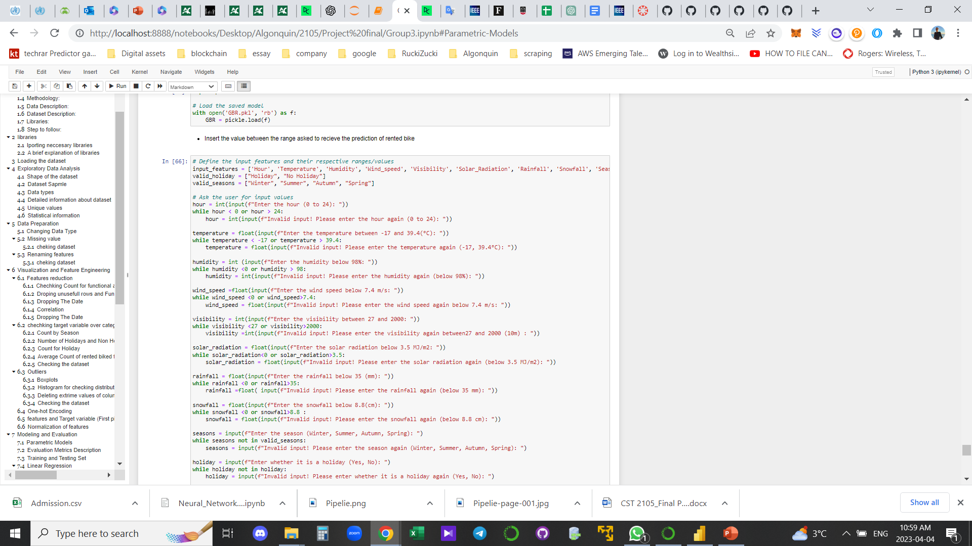
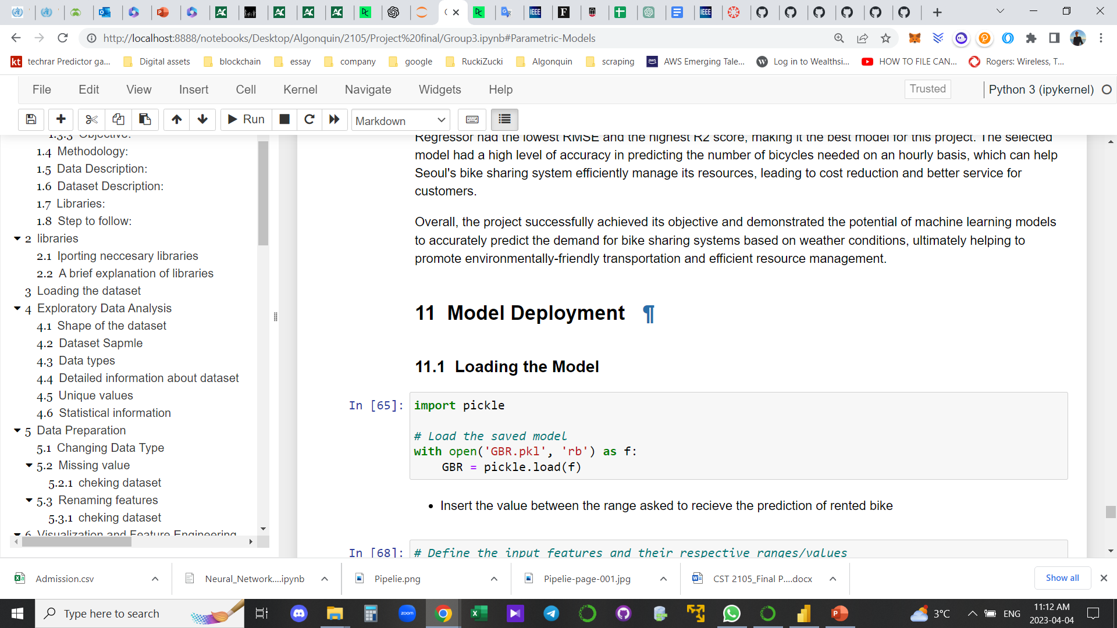
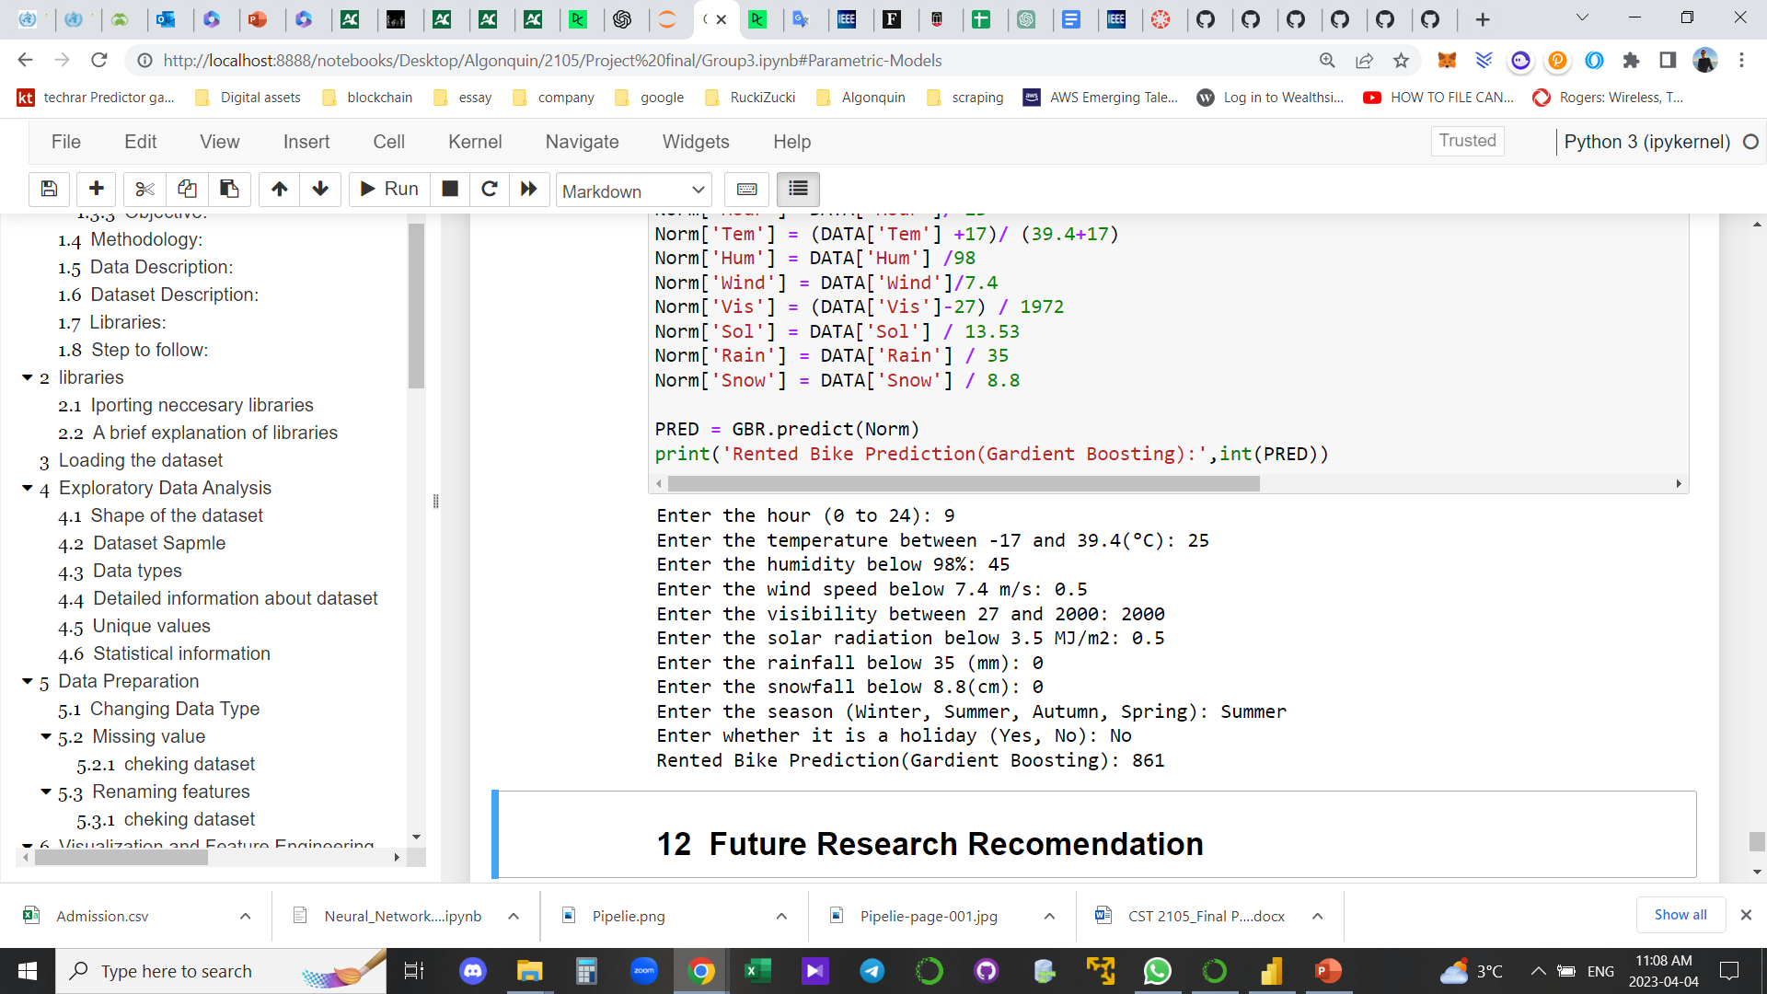












Model Deployment
Loading saved model
Prediction:

Slide 28
THANK YOU!
Mohammed Ahmadi, Zach Huntley, Anurag Singh

